Slide 1
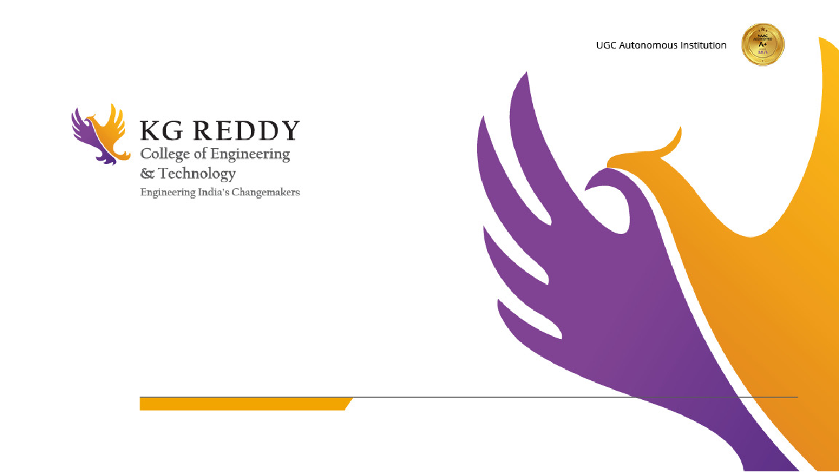



SCENE WEAVER
TECH HUB
R.KARTHIK B.AARTHIK
AKSHITHA NAMAJI

Slide 2
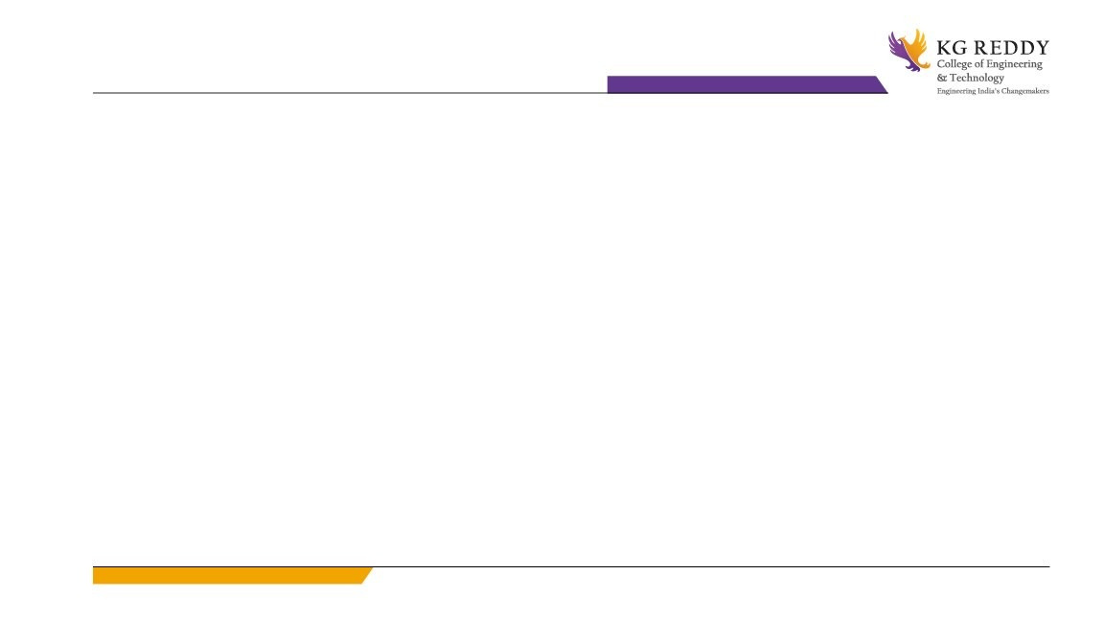
PROBLEM STATEMENT
Scriptwriting often requires multiple writers to contribute drafts for a single scene, which can lead to inconsistencies in tone, style, and flow. Manual analysis and synthesis of these drafts are time-intensive and prone to errors, resulting in delays and compromised script quality.
Year 1Year 2 Year 3 Year 4
Students

Slide 3
SOLUTION
Scene Weaver is a comprehensive platform designed to streamline the scriptwriting process by automating the analysis and synthesis of multiple drafts into a cohesive, polished scene. It combines advanced AI-powered tools with collaboration-focused features to tackle the challenges of collaborative writing efficiently
Year 1Year 2 Year 3 Year 4
Students

Slide 4
FEATURES
Room Creation and Management
Create new collaboration rooms or Access and manage existing projects.
Room Access via QR Code or Link
Collaboration Room
Real-time shared workspace for script writing, uploading, and downloading files.
Real-Time Notifications: Notify users of updates, new participants joining, or file changes.
Maintain a history of edits to scripts for easy rollback if needed.
Integrated Genius AI
AI tool for script analysis, suggestions, and improvements.
@Genius Bot Chat Support
Chatbot for resolving queries, script recommendations, and project guidance.

Slide 5
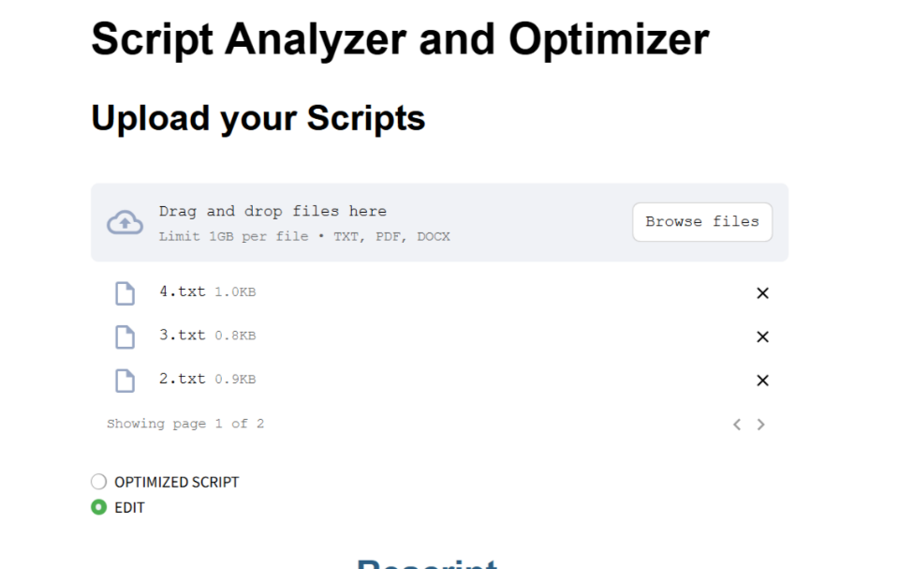
GENERATIVE AI
Groq API: Efficient AI Integration: Enables seamless communication with AI models for scene generation and optimization.
Scalability: Processes large-scale inputs and ensures fast, reliable responses for multiple users in real-time.
Flexibility: Offers APIs for integrating advanced AI features like script optimization, grammar checks, and context-based suggestions.
2. Llama 3, a large language model developed by Meta AI, is a highly advanced generative AI designed for tasks like natural language understanding, text generation, and complex problem-solving. It is an evolution of the Llama (Large Language Model Meta AI) series, optimized for efficiency and scalability.

Slide 6
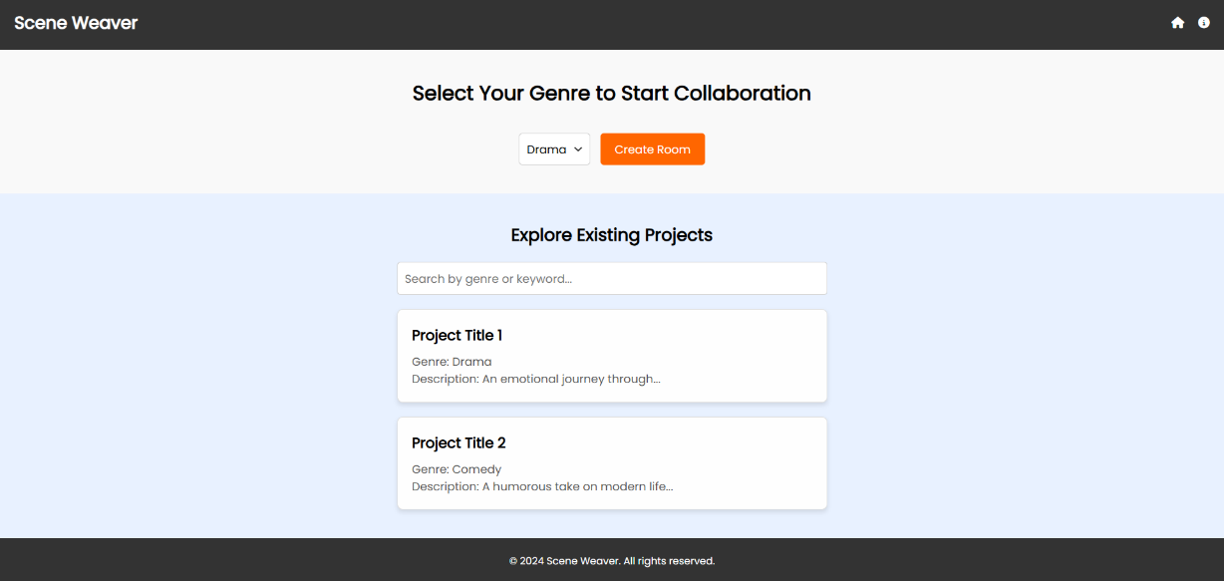
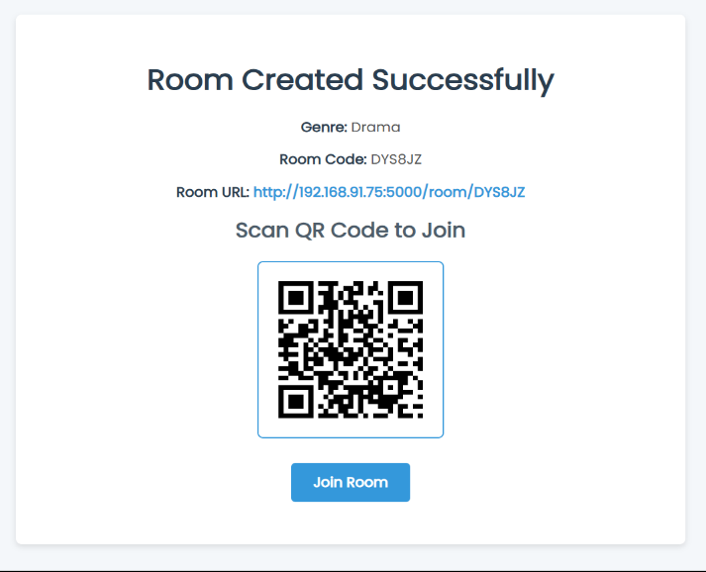
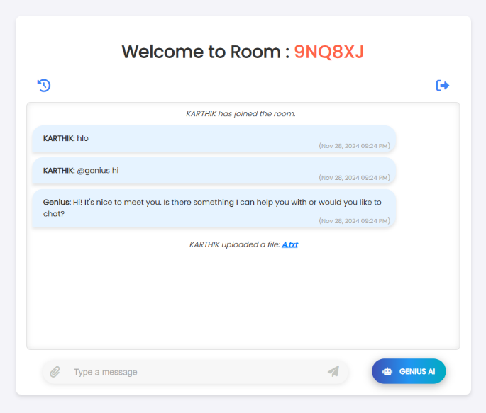
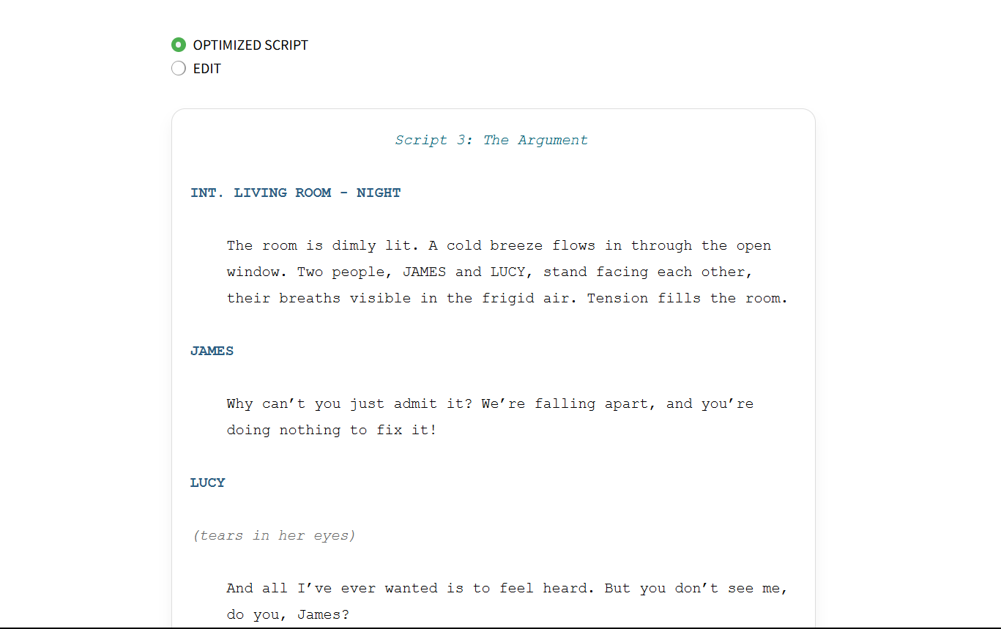
User Interface Design

Slide 7
TECHNOLOGIES USED
Frontend:
HTML: Markup language for structuring content on the web.
CSS: Styling language for designing the layout and appearance of web pages.
JavaScript: Programming language for dynamic and interactive behavior on web pages.
Backend:
Flask: A micro web framework for building web applications in Python.
SQLite3: A lightweight, disk-based database used for storing data in the application.
Socket.IO: A library for real-time, bidirectional communication between the web client and server.
Utilities & Libraries:
Werkzeug: A comprehensive WSGI web application library, used by Flask for various utilities.
Requests: A Python HTTP library for making requests to APIs and handling web data.
QR Code Generation:
QR Code: Technology for generating QR codes (likely using a Python library like qrcode).
5

Slide 8
Environment Configuration:
.env: A file used to store environment variables securely.
PDF & Document Handling:
PDFPlumber: A Python library for extracting text, tables, and metadata from PDF files.
python-docx (docx): A Python library for creating and modifying Word documents.
Data Processing & API:
Difflib : A Python library for comparing sequences, often used for text comparison or finding similarities.
GroqAPI: Likely referring to an API service for interacting with Groq, a company providing AI hardware solutions.
Machine Learning & AI:
Llama 3: Likely referring to a model or version of Llama, an open-source large language model developed by Meta (formerly Facebook).
Web Application:
Streamlit: An open-source app framework for building and sharing data apps, often used for creating interactive dashboards and visualizations.

Slide 9
THANK YOU!

